Slide 1
INTRODUCTION TO MICROPROCESSOR
Textbook: Microprocessors and Interfacing, Doughlas V. Hall, 3rd Edition

Slide 2
Why do we need to learn Microprocessors?
The microprocessor is the core of computer systems.
Nowadays many communication, digital entertainment, portable devices, are controlled by them.
A designer should know what types of components he needs, ways to reduce production costs and increase product reliability.

Slide 3
What is a Microprocessor?
The word comes from the combination micro and processor.
  Processor means a device that processes whatever. In this context processor means a device that processes numbers, specifically binary numbers, 0’s and 1’s.
    To process means to manipulate. It is a general term that describes all manipulation. Again in this content, it means to perform certain operations on the numbers that depend on the microprocessor’s design.

Slide 4
What is Micro?
Micro is a new addition.
  In the late 1960’s, processors were built using discrete elements.
    These devices performed the required operation, but were too large and too slow.
  In the early 1970’s the microchip was invented. All of the components that made up the processor were now placed on a single piece of silicon. The size became several thousand times smaller and the speed became several hundred times faster. The “Micro” Processor was born.

Slide 5
Definition of a Microprocessor.
The microprocessor is a programmable device that takes in numbers, performs on them arithmetic or logical operations according to the program stored in memory and then produces other numbers as a result.

Slide 6
Definition Continued.
Lets expand each of the underlined words:
  Programmable device: The microprocessor can perform different sets of operations on the data it receives depending on the sequence of instructions supplied in the given program.
  By changing the program, the microprocessor manipulates the data in different ways.
  Instructions: Each microprocessor is designed to execute a specific group of operations. This group of operations is called an instruction set. This instruction set defines what the microprocessor can and cannot do.

Slide 7
Definition Continued..
  Takes in: The data that the microprocessor manipulates must come from somewhere.
    It comes from what is called “input devices”.
    These are devices that bring data into the system from the outside world.
    These represent devices such as a keyboard, a mouse, switches, and the like.

Slide 8
Definition Continued…
  Numbers: The microprocessor has a very narrow view on life. It only understands binary numbers.
  A binary digit is called a bit (which comes from binary digit).
  The microprocessor recognizes and processes a group of bits together. This group of bits is called a “word”.
  The number of bits in a Microprocessor’s word, is a measure of its “abilities”.

Slide 9
Definition Continued
  Words, Bytes, etc.
    The earliest microprocessor (the Intel 8088 and Motorola’s 6800) recognized 8-bit words.
      They processed information 8-bits at a time. That’s why they are called “8-bit processors”. They can handle large numbers, but in order to process these numbers, they broke them into 8-bit pieces and processed each group of 8-bits separately.
    Later microprocessors (8086 and 68000) were designed with 16-bit words.
      A group of 8-bits were referred to as a “half-word” or “byte”.
      A group of 4 bits is called a “nibble”.
      Also, 32 bit groups were given the name “long word”.
    Today, all processors manipulate at least 32 bits at a time and there exists microprocessors that can process 64, 80, 128 bits or more at a time.

Slide 10
Definition Continued
    Arithmetic and Logic Operations:
      Every microprocessor has arithmetic operations such as add and subtract as part of its instruction set.
        Most microprocessors will have operations such as multiply and divide.
        Some of the newer ones will have complex operations such as square root.
      In addition, microprocessors have logic operations as well. Such as AND, OR, XOR, shift left, shift right, etc.
      Again, the number and types of operations define the microprocessor’s instruction set and depends on the specific microprocessor.

Slide 11
Definition Continued
  Program: A program is a sequence of instructions that bring data into the microprocessor, processes it and sends it out.
    There are many programming languages (C, C++, FORTRAN, and JAVA…) However, these programming languages can be grouped into three main levels (these days a fourth level is developing).

Slide 12
Definition Continued
  Programming Languages
    Machine language
      Machine language is the lowest level programming language. It is a language intended to be understood by the microprocessor (the machine) only.
      In this language, every instruction is described by binary patterns.
      e.g. 11001101 may mean 1 + 2
      This is the form in which instructions are stored in memory. This is the only form that the microprocessor understands.

Slide 13
Definition Continued
  Programming Languages
    Assembly language
      This language is more understandable by humans. In this language, the binary patterns are assigned mnemonics (short abbreviated names).
      e.g. “Add 1,2” is assigned to the machine language pattern 11001101 mentioned above to refer to the operation 1+2.

Slide 14
Definition Continued
  Programming Languages
    High level languages
      These are languages like C, PASCAL and FORTRON. These are more natural for humans to use than assembly or machine languages. They are also more compact (i.e. it takes less statements to write the program).
      One high level instruction translates into many assembly or machine language instructions.
      e.g. x = y + z may translate into:
      MOV R₁ ,1004
      MOV R₂ ,1000
        ADD R₁, R₂
        MOV R₁, 1004

Slide 15
Definition Continued
    Programming Languages
      The new level being developed: is ultra high level languages which would contain things like C++, and JAVA.
        Here a single instruction may translate into hundreds of assembly or machine language instructions.

Slide 16
Definition Continued
  Stored in memory :
    First, what is memory?
      Memory is the location where information is kept while not in current use.
      Memory is a collection of storage devices. Usually, each storage device holds one bit. Also, in most kinds of memory, these storage devices are grouped into groups of 8. These 8 storage locations can only be accessed together. So, one can only read or write in terms of bytes to and form memory.
      Memory is usually measured by the number of bytes it can hold. It is measured in Kilos, Megas and lately Gigas. A Kilo in computer language is 2¹⁰ =1024. So, a KB (KiloByte) is 1024 bytes. Mega is 1024 Kilos and Giga is 1024 Mega.

Slide 17
Definition Continued
  Stored in memory:
    When a program is entered into a computer, it is stored in memory. Then as the microprocessor starts to execute the instructions, it brings the instructions from memory one at a time.
    Memory is also used to hold the data.
      The microprocessor reads (brings in) the data from memory when it needs it and writes (stores) the results into memory when it is done.

Slide 18
Definition Continued
  Produces: For the user to see the result of the execution of the program, the results must be presented in a human readable form.
    The results must be presented on an output device.
    This can be the monitor, a paper from the printer, a simple LED or many other forms.

Slide 19
From the above description, we can draw the following block diagram to represent a microprocessor-based system
Input
Microprocessor
Output
Memory

Slide 20
Inside the Microprocessor.
Internally, the microprocessor is made up of 3 main units.
  The Arithmetic/Logic Unit (ALU)
  The Control Unit.
  An array of registers for holding data while it is being manipulated.

Slide 21
Organization of a Microprocessor based system
I/O
Input / Output
ALU
Register
Array
System Bus
Control
Memory
ROM RAM

Slide 22
Organization of the Microprocessor
    The microprocessor can be divided into three main pieces:
      Arithmetic/Logic Unit - Performs all computing and logic operations such as addition and subtraction as well as AND, OR and XOR.
      Register Array - A collection of registers within the microprocessor itself. These are used primarily for data storage during program execution. The number and the size of these registers differ from one microprocessor to the other.
      Control Unit - As the name implies, the control Unit controls what is happening in the microprocessor. It provides the necessary control and timing signals to all operations in the microprocessor as well as its contact to the outside world.

Slide 23
Micro-Processor/Computer/Controller
Microprocessor (µP)(MPU)
  A µP is a CPU on a single chip.
  Components of CPU
    ALU, instruction decoder, registers, bus control circuit, etc.
Micro-computer (µ-Computer)
  small computer
  µP + peripheral I/O + memory specifically for data acquisition and control applications
Microcontroller (µC)
  µ-Computer on a single chip of silicon

Slide 24
Microprocessors:
General-purpose microprocessor
CPU for Computers
No RAM, ROM, I/O on CPU chip itself
Example：Intel’s x86, Motorola’s 680x0
Many chips on mother’s board
Data Bus
CPU
General-Purpose Micro-processor
Serial COM Port
RAM
ROM
I/O Port
Timer
Address Bus
General-Purpose Microprocessor System
Notes:
Intel’s x86: 8086,8088,80386,80486, Pentium
Motorola’s 680x0: 68000, 68010, 68020,68030,6040

Slide 25
Microcontrollers
Memory
CPU
ROM RAM
I/O
Subsystems:
Timers, Counters, Analog
Interfaces, I/O interfaces
A single chip

Slide 26
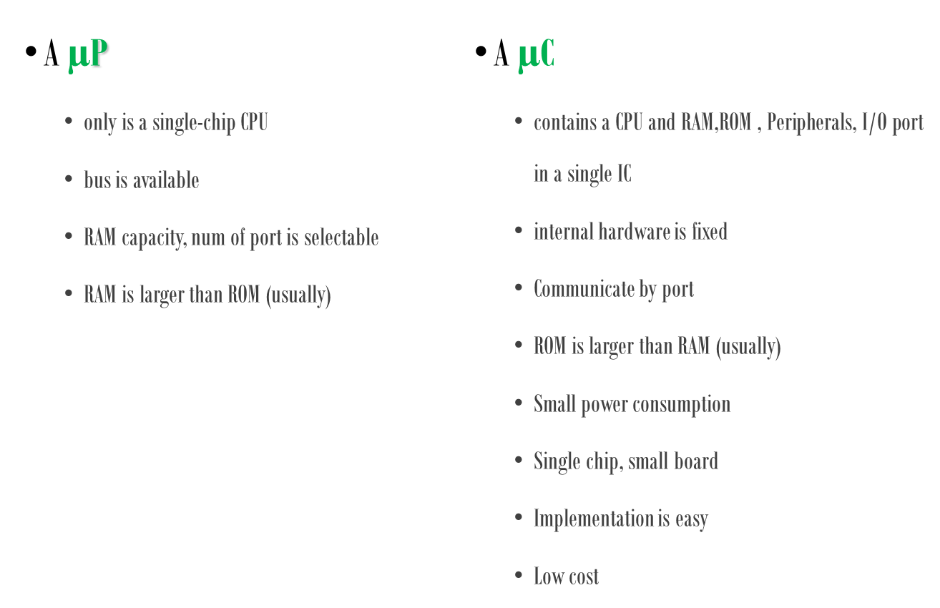
µP vs. µC

Slide 27
Microprocessor vs. Microcontroller
Microprocessor
CPU is stand-alone, RAM, ROM, I/O, timer are separate
designer can decide on the amount of ROM, RAM and I/O ports.
expansive
versatility
general-purpose
Microcontroller
CPU, RAM, ROM, I/O and timer are all on a single chip
fix amount of on-chip ROM, RAM, I/O ports
for applications in which cost, power and space are critical
single-purpose
Notes:
versatility: any number of applications for PC

Slide 28
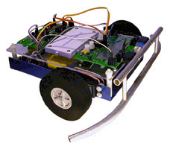
µP vs. µC – cont.
Applications
  µCs are suitable to control of I/O devices in designs requiring a minimum component
  µPs are suitable to processing information in computer systems.

Slide 29
µP vs. µC – cont.
µC is easy to use and design.
  Only single chip can be a complete system
  interfacing to other devices,
    for example, motors, displays, sensors, and communicate with PC.
In contrast, similar system that builds from µP would require a lot of additional units,
  such as RAM, UART, I/O , TIMER and etc.

Slide 30
µC is a Reusable Hardware
Logic circuit provides limited function for one single design. In order to change circuit’s functionality, we need to redesign the circuits.
µC can reprogram and change functionality of every port, input to output or digital to analog on the fly.

Slide 31
The Microprocessor (MPU)
The µP is the ‘brain of the microcomputer’
Is a single chip which is capable of
  processing data
  controlling all of the components which make up the microcomputer system
µP used to sequence executions of instructions that is in memory
µP Fetch , Decode , and Execute the instruction
The internal architecture of the microprocessor is complex.

Slide 32
Microprocessors
Microprocessors come in all kinds of varieties from the very simple to the very complex
Depend on data bus and register and ALU width µP could be 4-bit , 8-bit , 16-bit, 32-bit , 64-bit
All µPs have
  the address bus
  the data bus

Slide 33
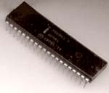
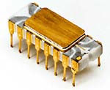
The first microprocessor to make it into a home computer was the Intel 8080, a complete 8-bit computer on one chip, introduced in 1974. The first microprocessor to make a real splash in the market was the Intel 8088, introduced in 1979 and incorporated into the IBM PC (which first appeared around 1982). If you are familiar with the PC market and its history, you know that the PC market moved from the 8088 to the 80286 to the 80386 to the 80486 to the Pentium to the Pentium II to the Pentium III to the Pentium 4. All of these microprocessors are made by Intel and all of them are improvements on the basic design of the 8088. The Pentium 4 can execute any piece of code that ran on the original 8088, but it does it about 5,000 times faster!
Intel 8080

Slide 34
Name | Date | Transistors | Microns | Clock speed | Data width | MIPS
8080 | 1974 | 6,000 | 6 | 2 MHz | 8 bits | 0.64
8088 | 1979 | 29,000 | 3 | 5 MHz | 16 bits 8-bit bus | 0.33
80286 | 1982 | 134,000 | 1.5 | 6 MHz | 16 bits | 1
80386 | 1985 | 275,000 | 1.5 | 16 MHz | 32 bits | 5
80486 | 1989 | 1,200,000 | 1 | 25 MHz | 32 bits | 20
Pentium | 1993 | 3,100,000 | 0.8 | 60 MHz | 32 bits 64-bit bus | 100
Pentium II | 1997 | 7,500,000 | 0.35 | 233 MHz | 32 bits 64-bit bus | ~300
Pentium III | 1999 | 9,500,000 | 0.25 | 450 MHz | 32 bits 64-bit bus | ~510
Pentium 4 | 2000 | 42,000,000 | 0.18 | 1.5 GHz | 32 bits 64-bit bus | ~1,700
Pentium 4 "" | 2004 | 125,000,000 | 0.09 | 3.6 GHz | 32 bits 64-bit bus | ~7,000

Slide 35
Information about this table:
The date is the year that the processor was first introduced. Many processors are re-introduced at higher clock speeds for many years after the original release date.
Transistors is the number of transistors on the chip. You can see that the number of transistors on a single chip has risen steadily over the years.
Microns is the width, in microns, of the smallest wire on the chip. For comparison, a human hair is 100 microns thick. As the feature size on the chip goes down, the number of transistors rises.
Clock speed is the maximum rate that the chip can be clocked at. Clock speed will make more sense in the next section.
Data Width is the width of the ALU. An 8-bit ALU can add/subtract/multiply/etc. two 8-bit numbers, while a 32-bit ALU can manipulate 32-bit numbers. An 8-bit ALU would have to execute four instructions to add two 32-bit numbers, while a 32-bit ALU can do it in one instruction. In many cases, the external data bus is the same width as the ALU, but not always. The 8088 had a 16-bit ALU and an 8-bit bus, while the modern Pentiums fetch data 64 bits at a time for their 32-bit ALUs.
MIPS stands for "millions of instructions per second" and is a rough measure of the performance of a CPU. Modern CPUs can do so many different things that MIPS ratings lose a lot of their meaning, but you can get a general sense of the relative power of the CPUs from this column.

Slide 36
What's a Chip?
A chip is also called an integrated circuit.
Generally it is a small, thin piece of silicon onto which the transistors making up the microprocessor have been etched.
A chip might be as large as an inch on a side and can contain tens of millions of transistors.
Simpler processors might consist of a few thousand transistors etched onto a chip just a few millimeters square.

Slide 37
History
Company | 4 bit | 8 bit | 16 bit | 32 bit | 64 bit
Intel | 4004 4040 | 8008 8080 8085 | 8088/6 80186 80286 | 80386 80486 | 80860 Pentium
zilog |  | Z80 | Z8000 Z8001 Z8002
Motorola |  | 6800 6802 6809 | 68006 68008 68010 | 68020 68030 68040

